Slide 1
infogathering
@theroxyd
@planohackspace
roxy@thelab.ms

Slide 2
disclaimers
I haven't stored any information
Everyone willingly gave information or it was found where anyone could access it
My employer is not involved...
...but I did do a lot of these slides when I was supposed to be working so LOL
(I spent over an hour at work cruising photobucket)

Slide 3
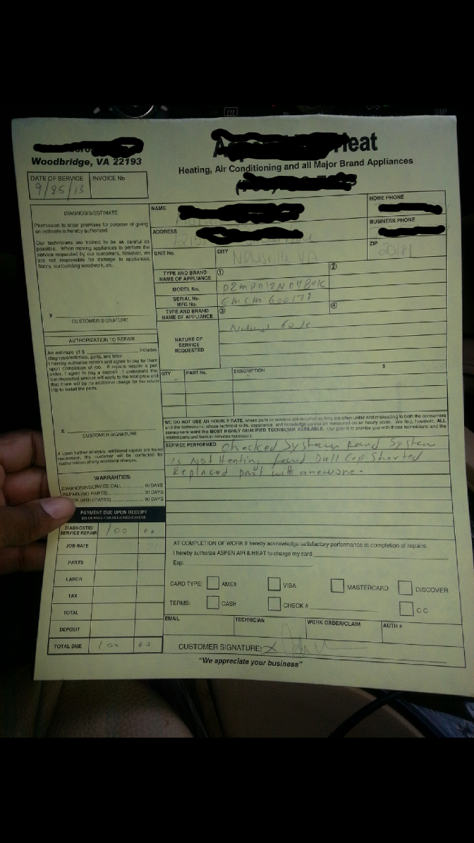
what are we getting?
Information on a target - individual or groups
Specific Information

Slide 4
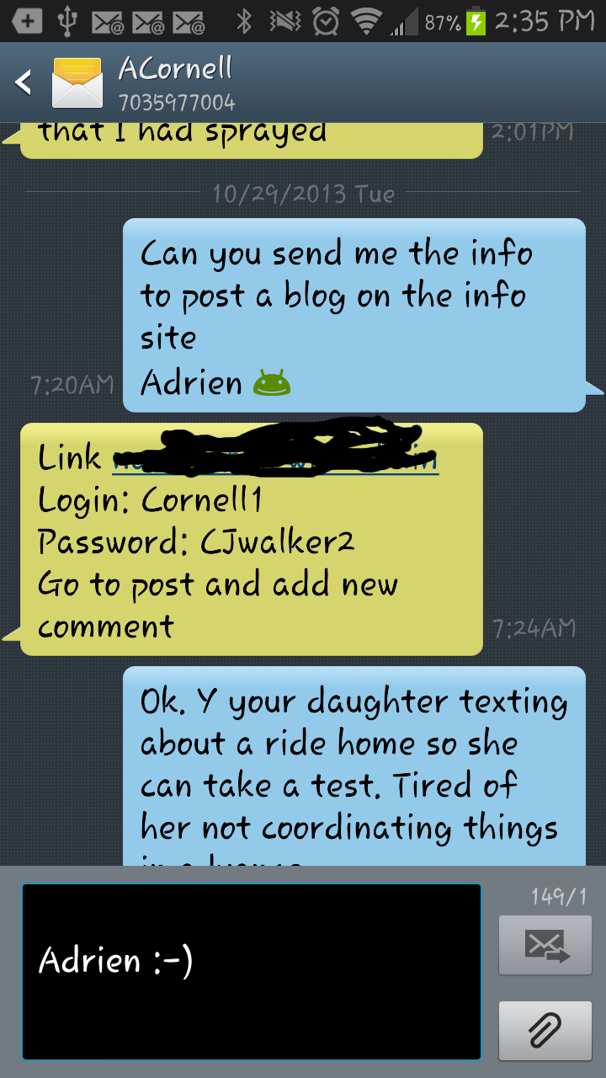
Why???????
Skiptracing
Pentest
Safety
Fun & Profit (probably wrong & rude)

Slide 5
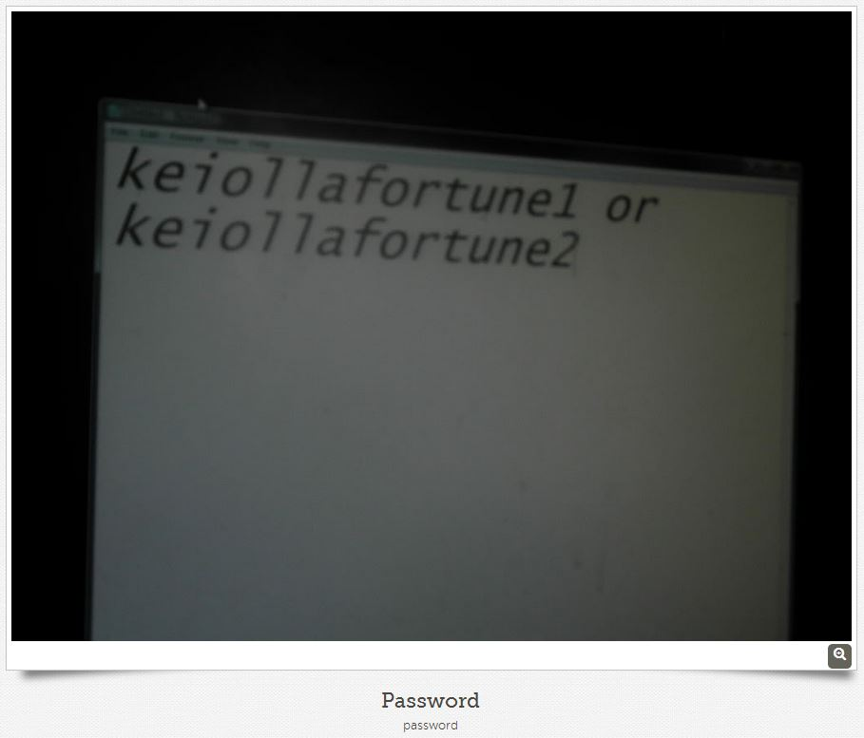
How are we getting it?
Googling
Public Records
Social Media
Social Engineering
Observation
SEToolkit

Slide 6
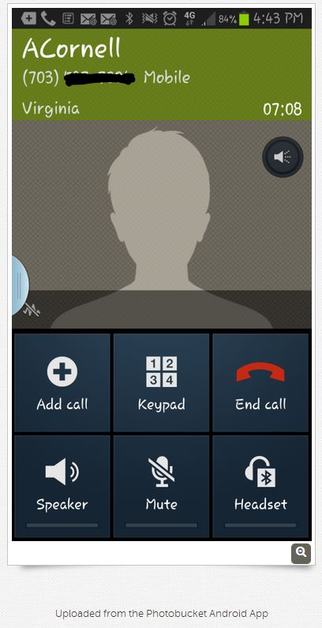
individuals
Search name, e-mail address, & e-mail's username
Obtain additional usernames
Social Media (helps to have a fake account)
Search Public Records
Ask people for information
Listen to the target and ask questions

Slide 7
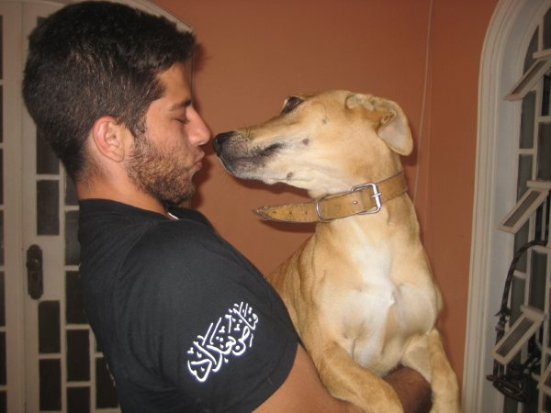
Google search: Chess guy
My coworker thought that this guy was my soulmate so I did some research using only google.
Myspace profile w/picture
First name, middle initial, last name
Plays a lot of online poker
Was on Wheel of Fortune
Married for 1 yr

Slide 8
Be careful when you click on craigslist links...
...you might be playing a version of "Find the Fetish"

Slide 9
GOOGLING...
Name and age
Places I've lived (years weren't completely accurate)
Relatives
High School
Classmates that I don't remember
A tiny picture...

Slide 10
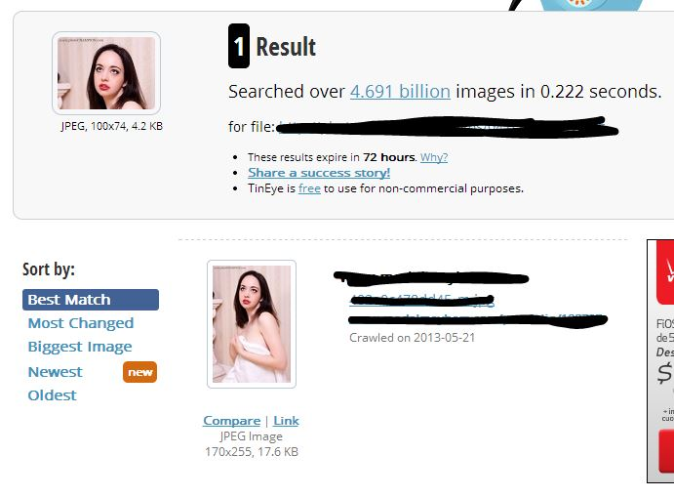
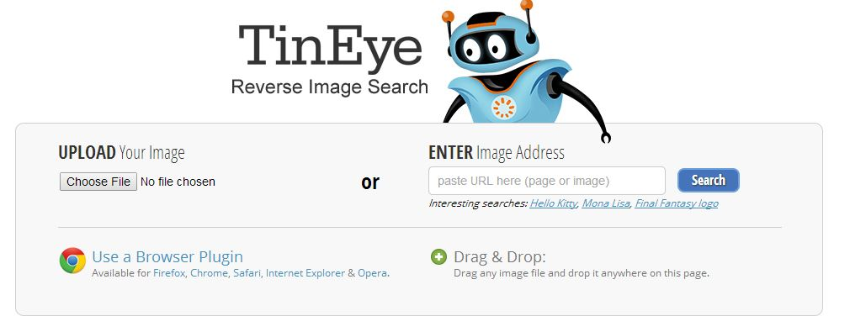
i love tineye!

Slide 11
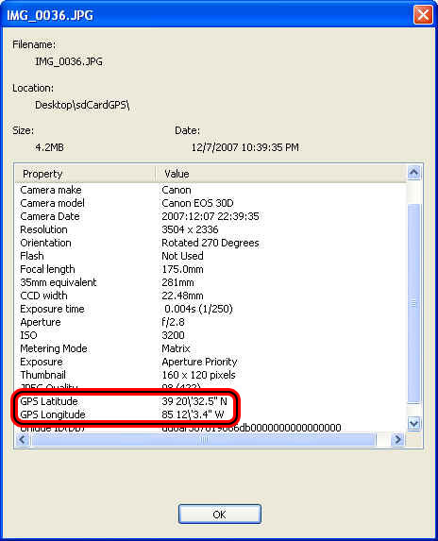
Locating
EXIF data
Location shared on social media

Slide 12
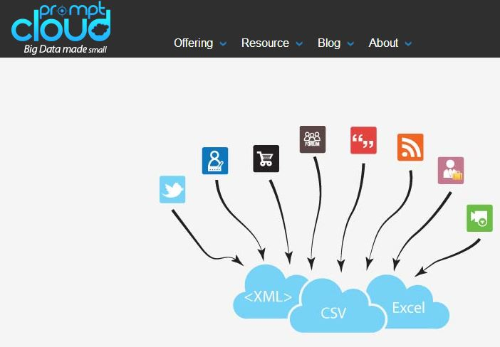
social media
scrape data
get data from a social media crawler
friend your target with a fake account
search username on different websites
reverse e-mail search (ex. Spokeo)
Pastebin!

Slide 13
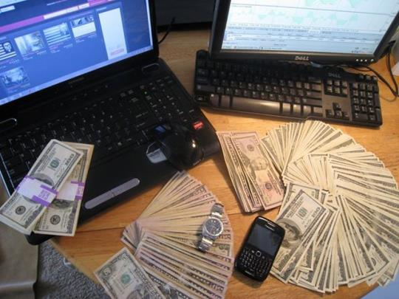
Public records
Usually only need name and DOB
Most counties now have court records online - Marriage, Divorce, Arrest records
Sex Offender registry

Slide 14
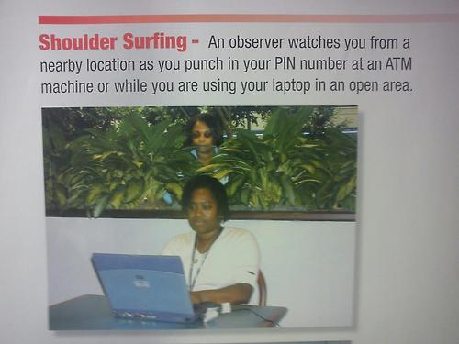
SE & Observation
Listen to your target
Observation
Shoulder surf & dumpster dive
Pretend like you know something
Get information from people around your target
Just ask your target!

Slide 15
groups
Similar tactics used for individuals except more social engineering!

Slide 16
Make some phone calls (1/2)
Become familiar with website; whois for more domains
Become familiar with the staff - this gives credibility. Research "About Us" on website
Name drop
"I'm from corporate" or "I hear you're having computer problems?"
Evoke empathy "I need this info for my boss" "I want to go home"
Most people like helping

Slide 17
Make some phone calls (2/2)
Feed egos
Be descriptive - even if you're describing every possibility
Webcams - more on this later
Just ask for what you want - you'll be surprised
Every detail counts. You can use even the smallest info to sound more credible or to gather additional information.

Slide 18
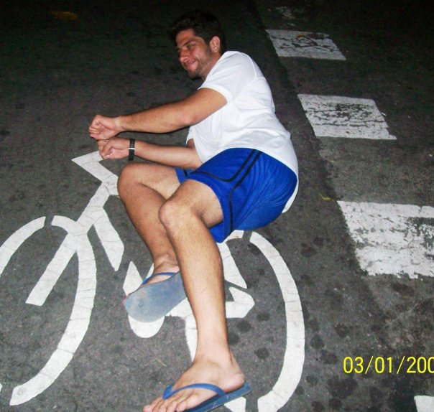
Not as social
You're delivering a package or there to help - wear a costume!
"Hold that door for me" or sneak in after someone
Shoulder surf that door code
Dumpster diving
Look in windows & read paper on desks
leave some flash drives - use SEToolkit
QR codes - use SEToolkit

Slide 19
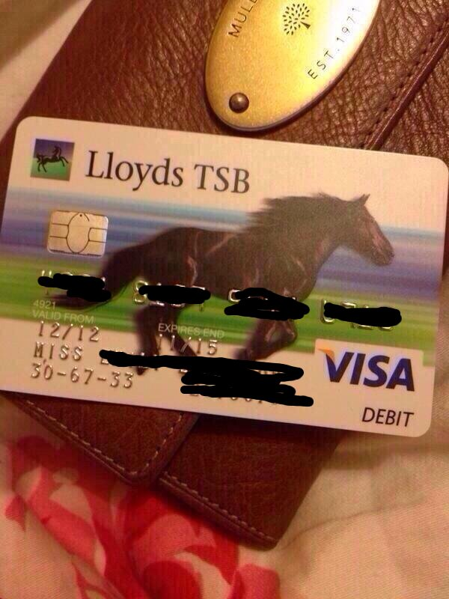
finding specific information
Scrapers & social media searches
Googling (Recommended: Google Hacking for Penetration Testers by Johnny Long)
Cameras
Just ASK! (craigslist is great for this)

Slide 20
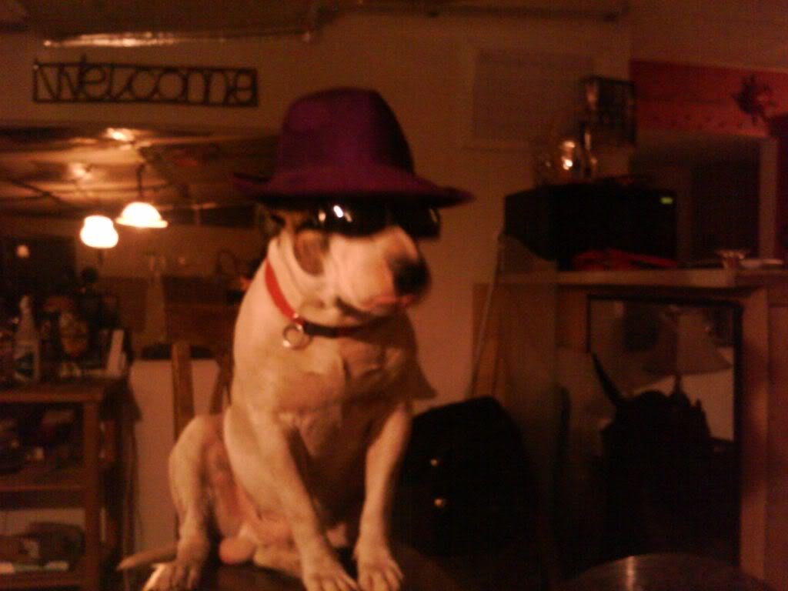
Previously mentioned
Pastebin
Image sharing sites
QR codes
Drop some flash drives
Dumpster Diving
Window Surfing

Slide 21
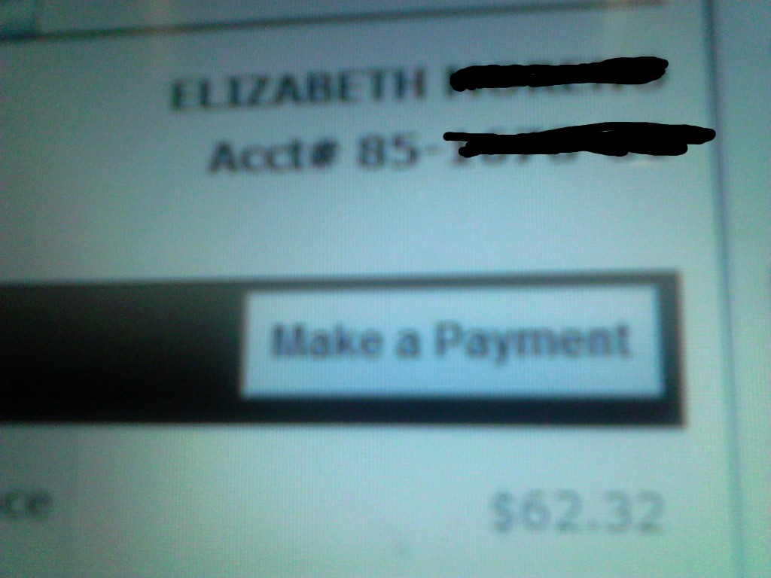
Social media
Search for "new credit card" "new phone number" "new license" etc

Slide 22
Google Hacking - Johnny Long
Personal information
Credit Cards
Public Records
Logins that are using the default
Webcams!
...much much much more

Slide 23
ask some people on craigslist
You can e-mail your question and see if anyone bites...

Slide 24
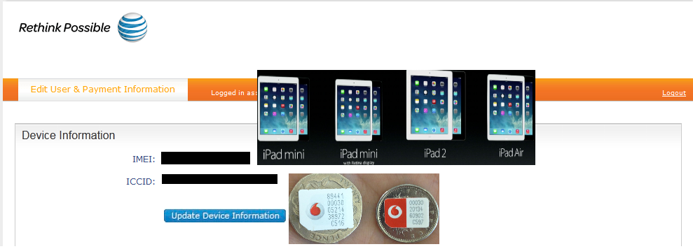

Slide 25
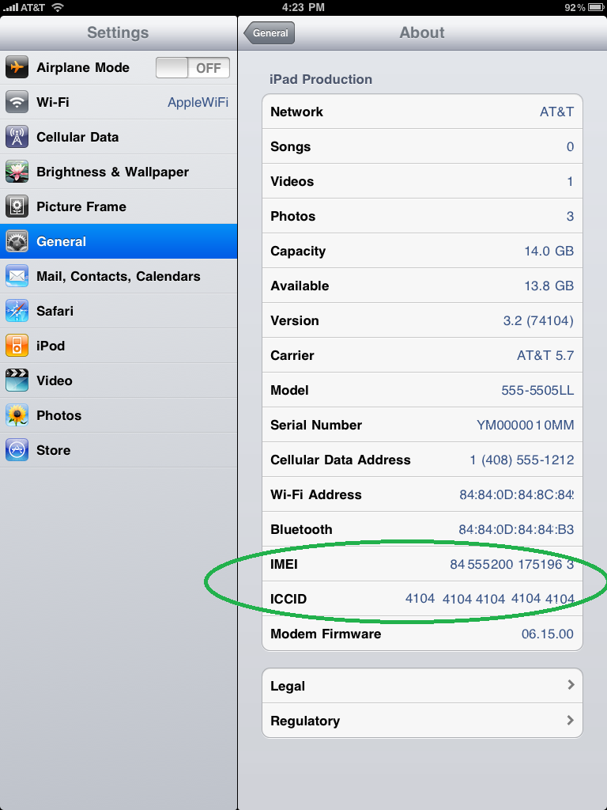

Slide 26
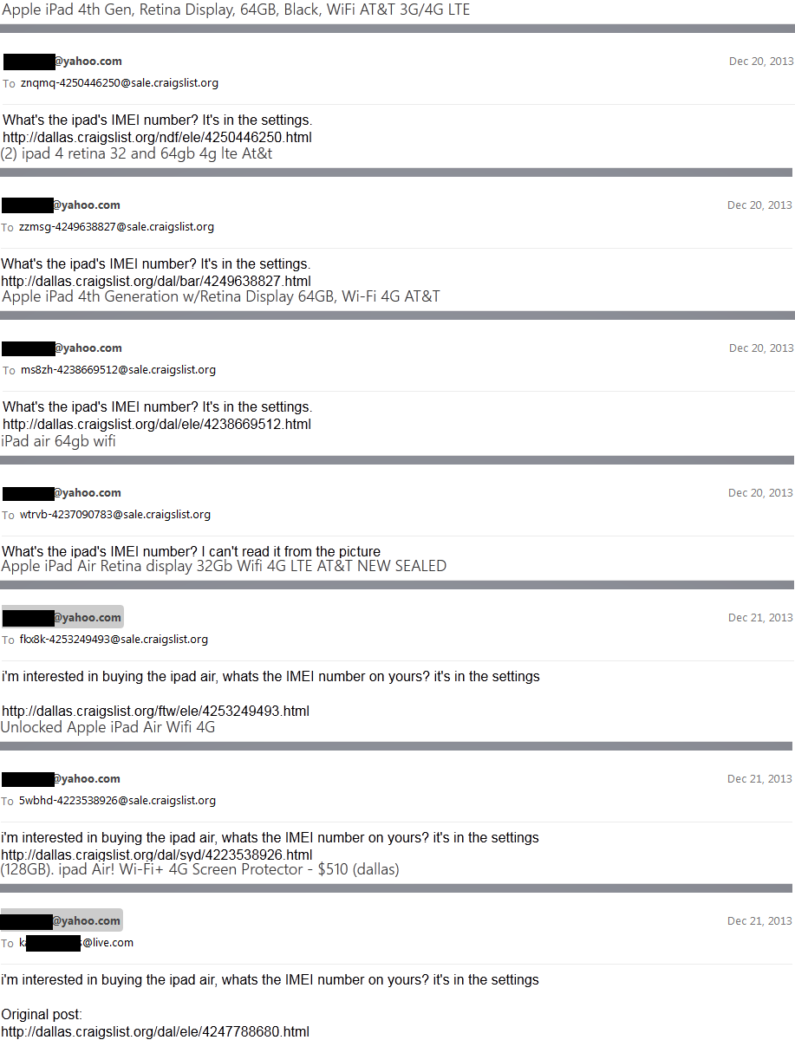
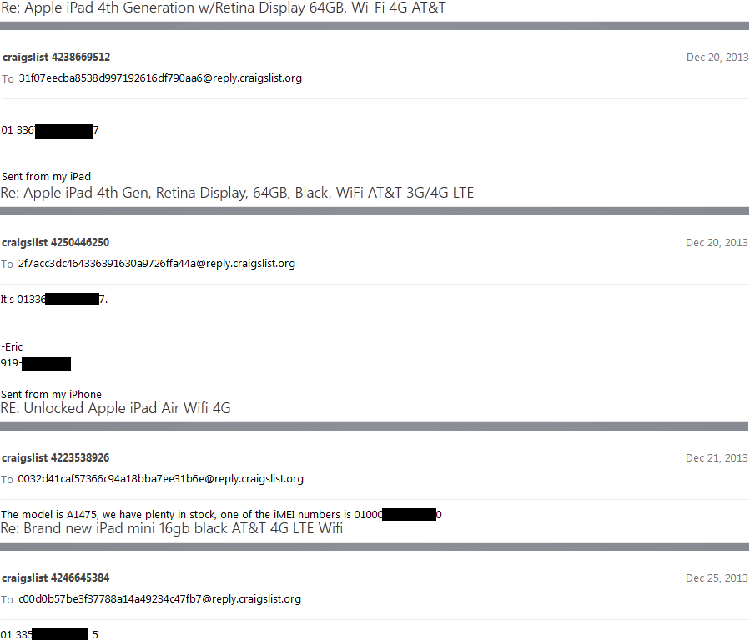

Slide 27
SeToolkit
Now I'll just ramble about SEToolkit because I'm not making slides on it

Slide 28
I'm done. Here's some resources:
SEToolkit: www.trustedsec.com/downloads/social-engineer-toolkit Social Media data: www.gnip.com Reverse image search: www.tineye.com Johnny Long's Google hacking book: amzn.com/1597491764 Plano Hackerspace twitter: @planohackspace
Contact me if you have questions or need resources/ideas/help My twitter: @theroxyd My e-mail: roxy@thelab.ms

